Slide 1
PROJECT BASED LEARNING
TITLE
STATIONARY SHOP MANAGEMENT SYSTEM
BY:-
Megha Mishra

Slide 2
Abstract
In this project we have programmed the working and functioning of a stationary shop.
This program will enable the shopkeeper to manage the shop by revealing the present status of the shop.
This program will provide the basic idea of the stationary items present in the shop , their price , number of items present and purchased , their MRP and discount offer , etc.

Slide 3
It will also tell about the various books present in the shop including their details(author name , publication , core subject , price , etc.).
It will also do the billing for the customer.

Slide 4
PROPOSED WORK
We have written a program for searching in string, so that when the customer will enter the name of book required, that particular book can be searched in the string present.
The program also tells the shopkeeper about the objects which are insufficient in number.
Also as the items will be purchased its quantity will be subtracted from the persent stock.
We have also added membership in this program..eg whether the customer is a regular customer or new.
Our program will work according to the flow chart given in the following slides.

Slide 5
PROPOSED SYSTEM…
IN FINAL REVIEW PAYMENT MODES WILL BE ADDED ALONG WITH GIFT VOUCHERS…

Slide 6
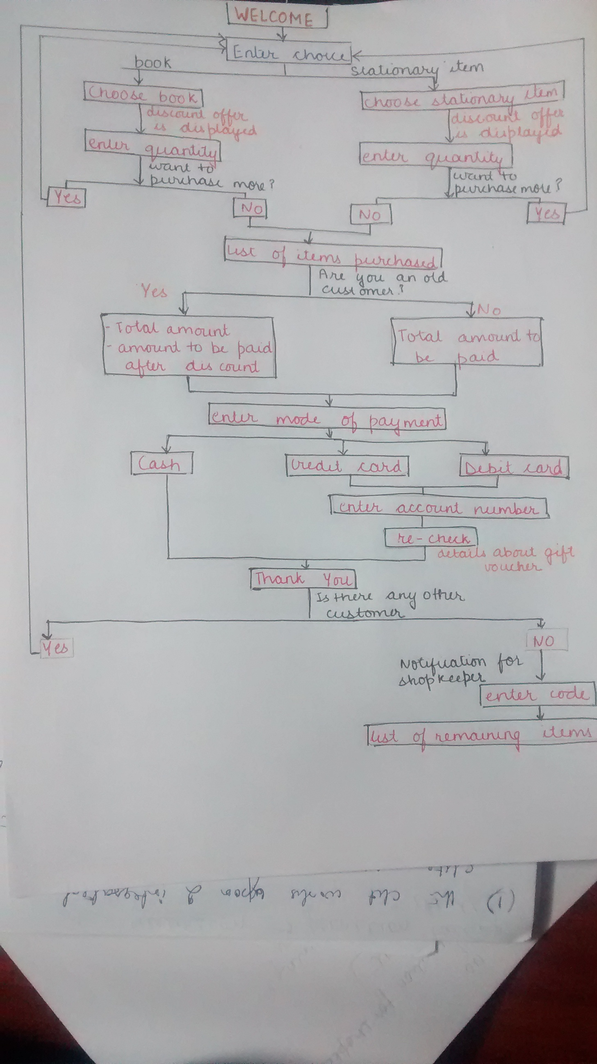

Slide 7
Enter choice
Books
other stationary items
choose the book
(special discount offers are displayed)
Choose the item
(special discount offers are displayed)
Book name
Pencil,pen,etc.
Enter the quantity
Enter the quantity
YES
Want to purchase more
NO
List of items purchased is displayed
Are you an old customer or new
If old Than billing is done by offering discount
If new than no special discount is offered
Final billing is done according to net discount offered
PRESENT WORK

Slide 8
MODULE 1 ITEMS TO BE PURCHASED
In this module the customer will enter the items to be purchased. The user must specify whether the items to be purchased is books or other stationary items.
The user must also specify the quantity of items he/she wants to purchase.

Slide 9
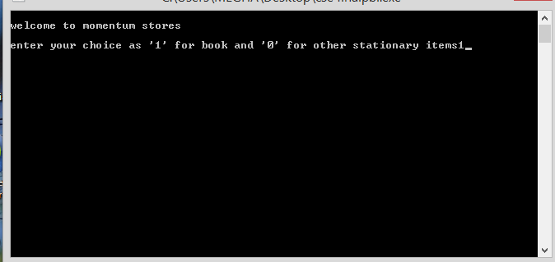
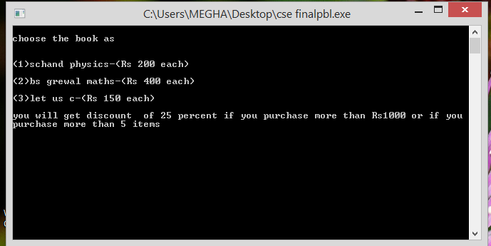

Slide 10
MODULE 2 AVAILABILITY
In this module the program will read the requirement of the customer.
The program will check in the stock available that whether the required item is present or not.
If present than that item will be provided to the user and the number of items in the stock will be reduced.

Slide 11
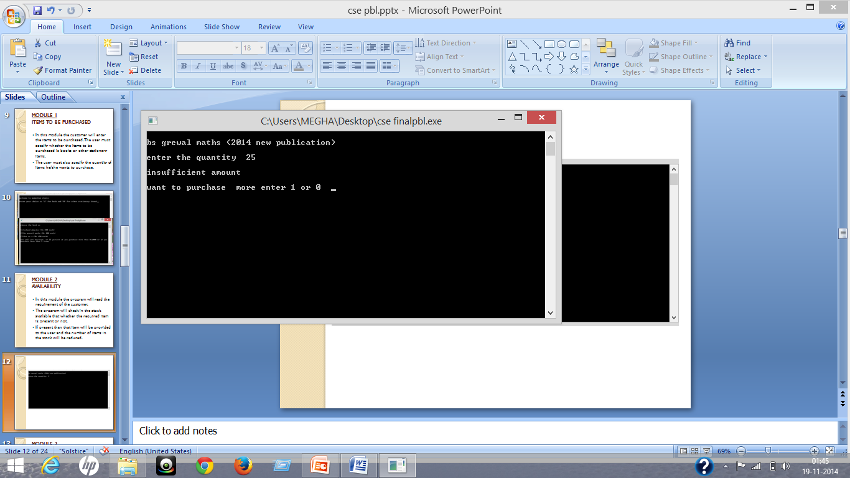
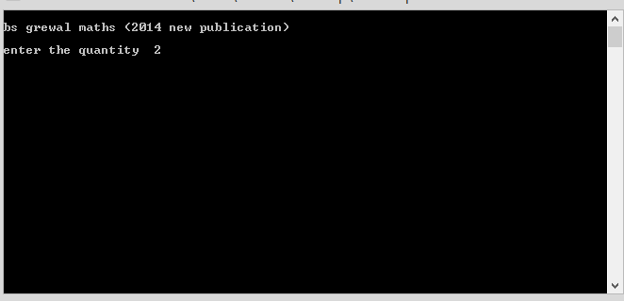

Slide 12
MODULE 3 LIST OF ITEMS PURCHASED
Here the total number of items purchased by the user is displayed.
The quantity of items purchased is also displayed in this module.

Slide 13
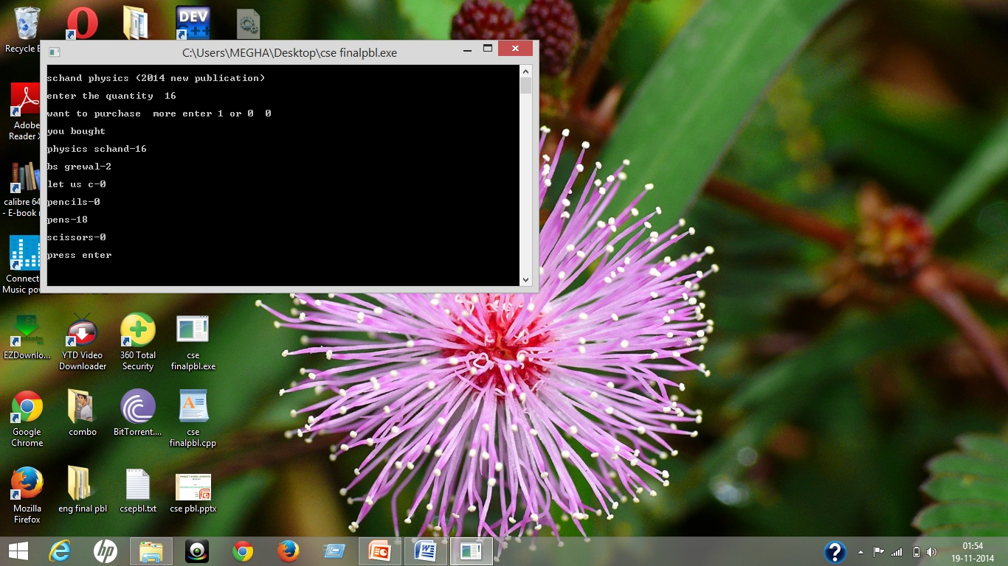

Slide 14
MODULE 4 DISCOUNT OFFERS & BILLING
In this, the customer is asked if he is an old customer.
Discount offers are displayed by the program for an old customer.
25% discount will be offered to old customers

Slide 15
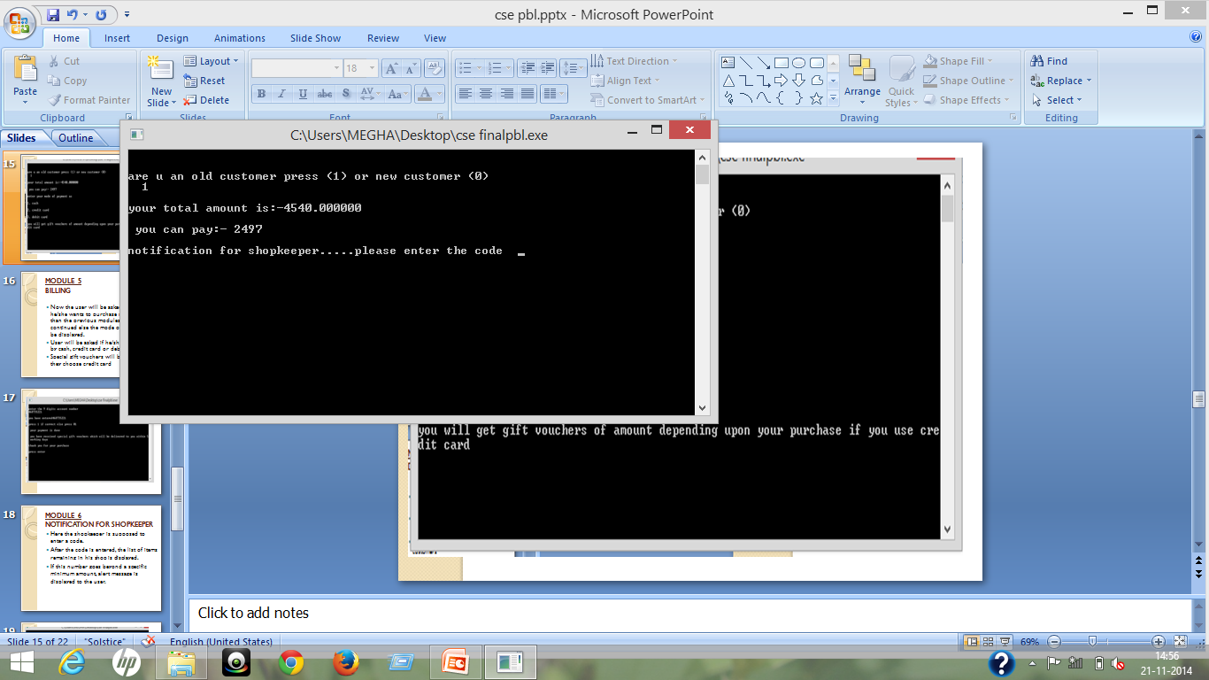

Slide 16
MODULE 6 NOTIFICATION FOR SHOPKEEPER
Here the shopkeeper is supposed to enter a code.
After the code is entered, the list of items remaining in his shop is displayed.
If this number goes beyond a specific minimum amount, alert message is displayed to the user.

Slide 17
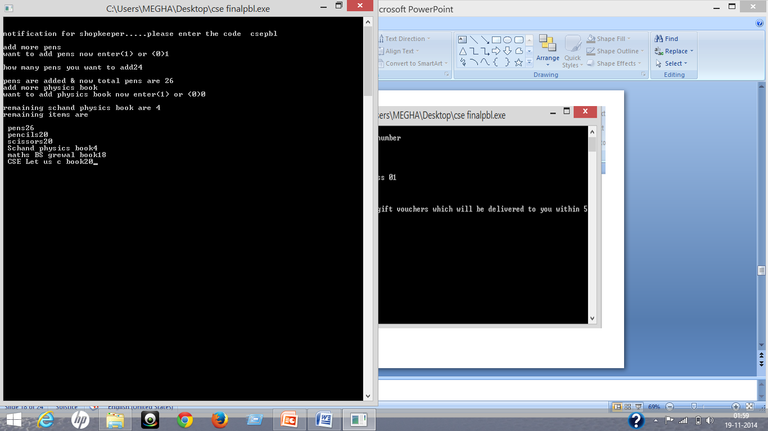

Slide 18
CONCLUSION
In this project we have designed a sysem which enables the shopkeeper to keep a check on the quantity of different items left in his shop.
Alert message is displayed if any goes beyong a specific minimum number.
The future of this project would be enabling the shopkeeper to purchase the items automatically online, when it is present in less quantity.
For this the user will have to specify sites to be referred for certain commodity.

Slide 19
REFERENCES:
WEBSITES:
www.google.com
Wikipedia.
BOOKS:
Let us C by Yashavant Kanetkar
C programming by Sunita Arora

Slide 20
THANK YOU

